Slide 1
Voyage Analytics: Integrating MLOps in Travel
Productionization of ML Systems

Slide 2
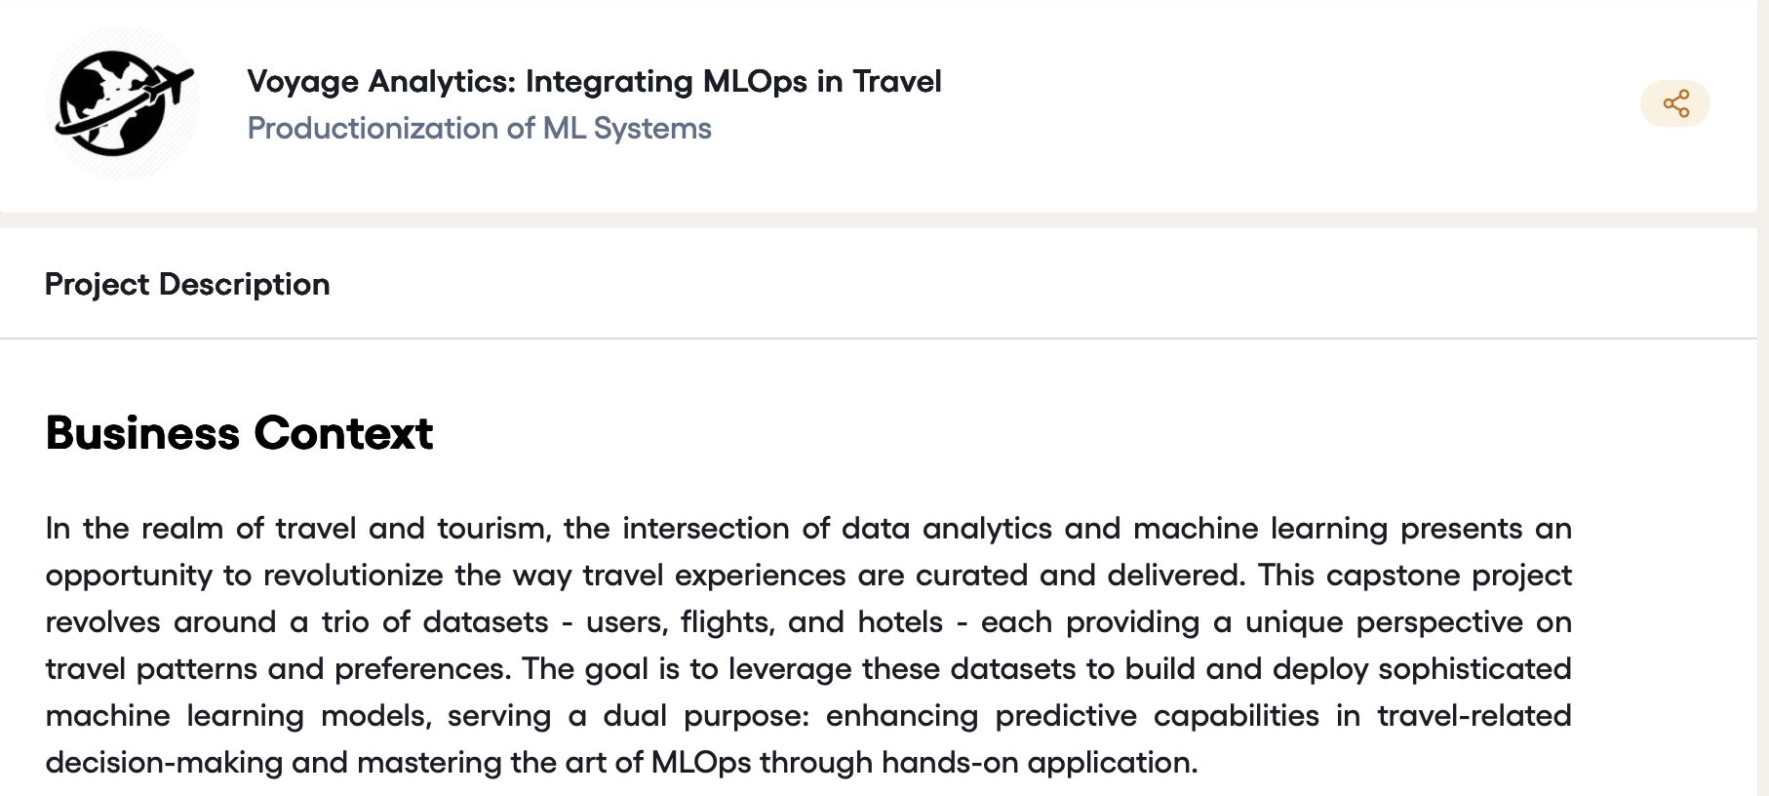

Slide 3
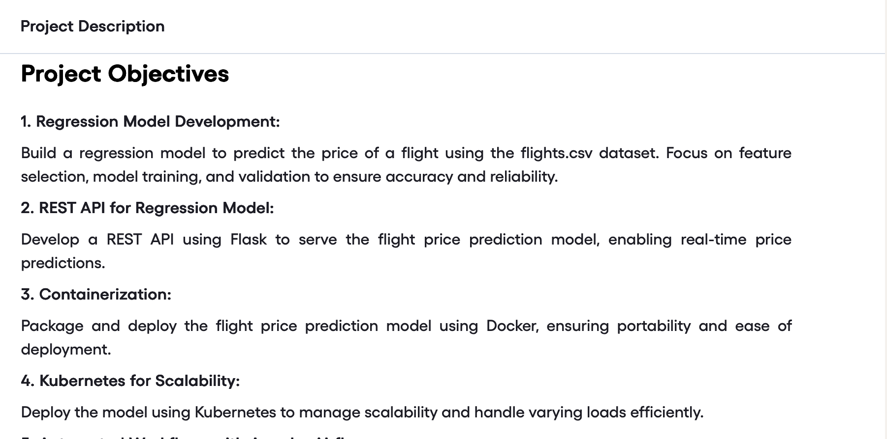

Slide 4
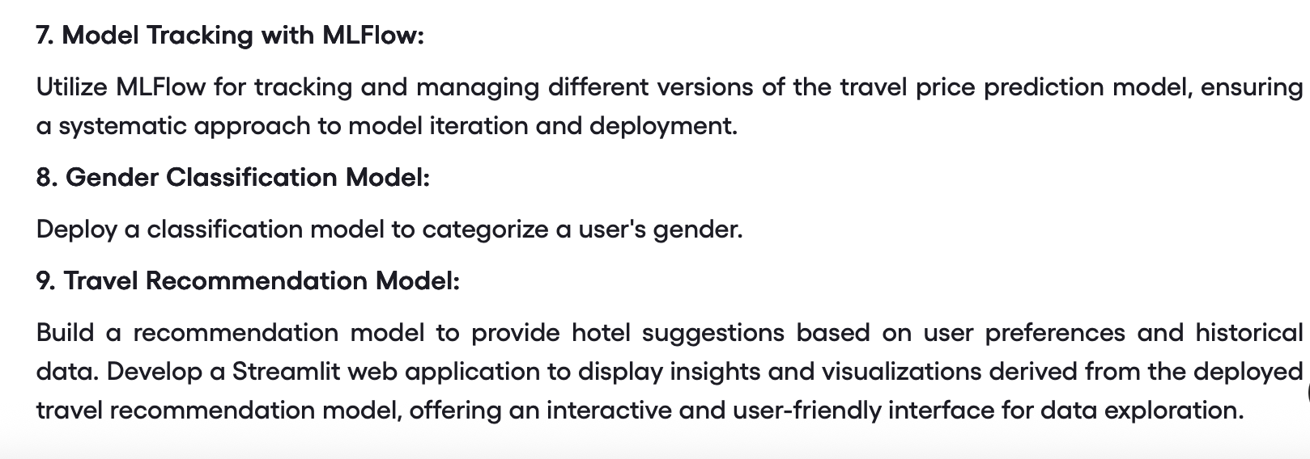

Slide 5
Youtube link - https://www.youtube.com/watch?v=oLQQfL3pUDc

